Slide 1
CSE 320/EEE361 Data Communications
Digital Transmission
Chapter 4

Slide 2
4-2 Analog Data → Digital Signal

Slide 3
Analog Data → Digital Signal
Topics discussed in this section:
Pulse Code Modulation (PCM) Delta Modulation (DM)

Slide 4
Delta Modulation

Slide 5
Delta Modulation
To improve the performance of PCM (reduce complexity)
Analog input is approximated by a staircase function
Move up or down one quantization level (δ) at each sample interval
Binary behavior—important characteristic
Function moves up or down at each sample interval

Slide 6
Delta Modulation
This scheme sends only the difference between pulses, if the pulse at time t_{n+1} is higher in amplitude value than the pulse at time t_{n}, then a single bit, say a “1”, is used to indicate the positive value.
If the pulse is lower in value, resulting in a negative value, a “0” is used.
This scheme works well for small changes in signal values between samples.
If changes in amplitude are large, this will result in large errors.

Slide 7
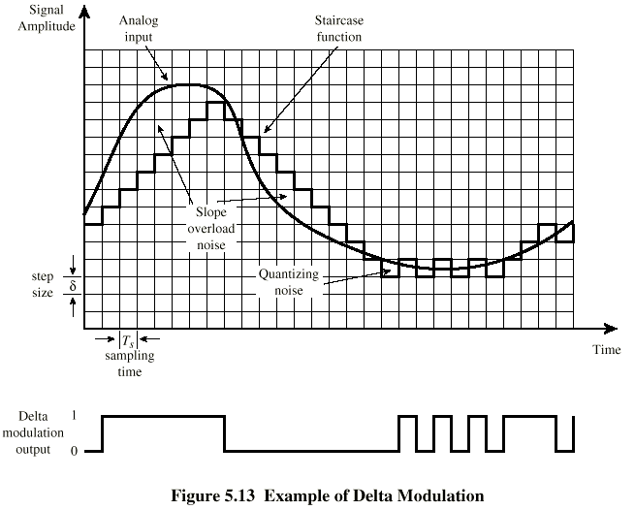
Delta Modulation - example

Slide 8
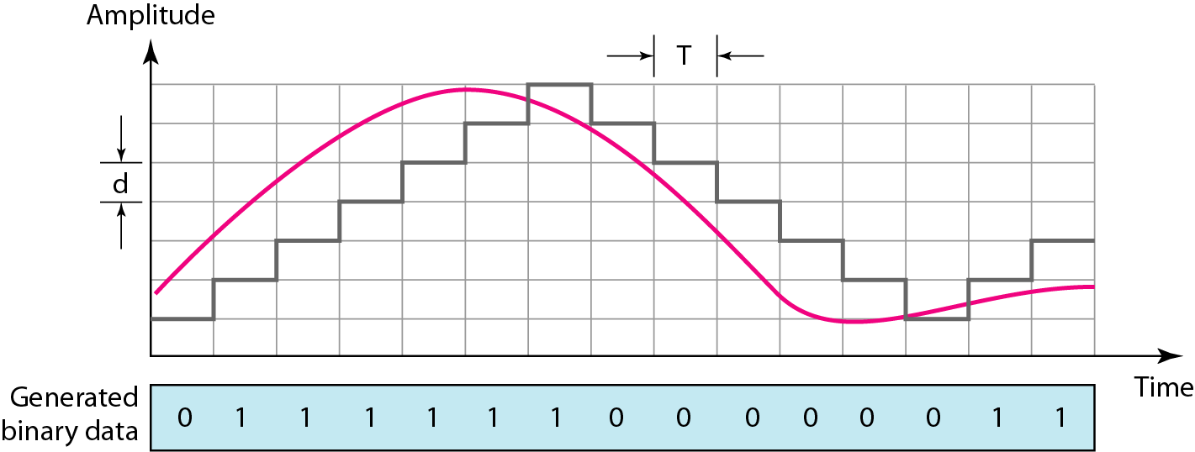
The process of delta modulation

Slide 9
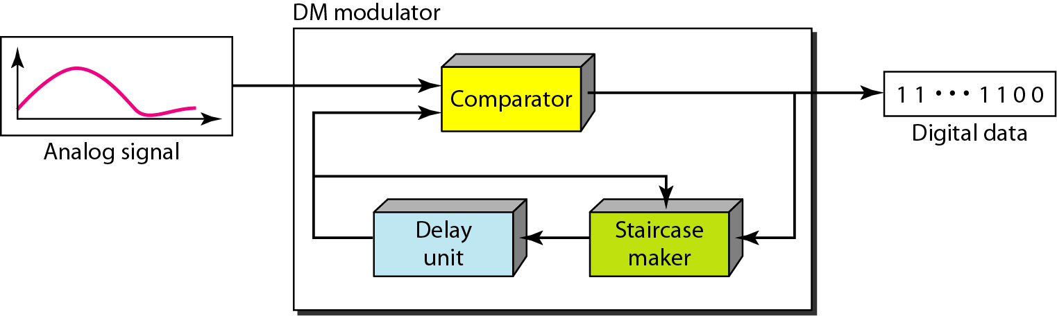
Figure 4.29 Delta modulation components

Slide 10
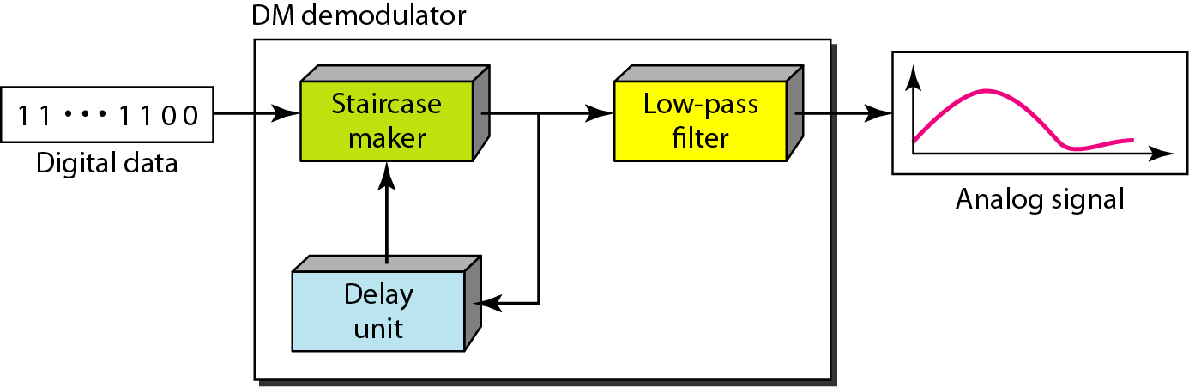
Figure 4.30 Delta demodulation components

Slide 11
Delta Modulation
2 important parameters are
size of the step δ
the sampling rate.

